Slide 1
N-gram word-based model
Khanh Nguyen, Giau Tran

Slide 2
Outline:
Data Description
Model Language
The source channel model
Task 1 – Task 2
Laplace smoothing as model interpolation
Interpolation of individual n-gram models
Interpolation among several n-gram models
What: which models to interpolate?
How: how much to weigh each model during interpolation?
Going further:
Current state of ngram language models
Current state of language models

Slide 3



Data Description:
trainW: Word Alphas: contains only [[:alpha:]] words (words that only have letters, no numbers or symbols)
trainT: A Storm of Swords by George R.R. Martin
test1: A Dance of Dragons by George R.R. Martin
test 2: Gone With the Wind by Margaret Mitchell
a
aa
aaa
aah
aahed
Same size
Consistent to the training
Different type
Each of dataset was be under word-processing.

Slide 4
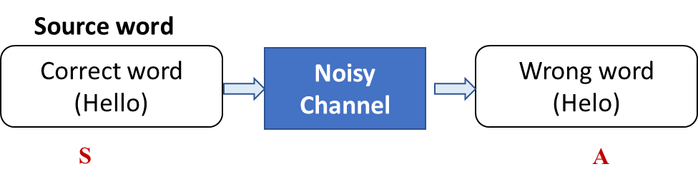
The source-channel model:
Spell Correction
Source word
Correct word
(Hello)
Noisy Channel
Wrong word
(Helo)
S
A
Guess s (correct word)
Given only A (wrong word)
We will do it as:
s∗ = argmax(P(s)|A)
Using Bayes rule to reverse dependencies s∗ = argmaxP(s)P(A|s)
P(s): Language Model Quantifies the plausibility of word sequences
P (A|s): Noise model
Find highest probablility

Slide 5
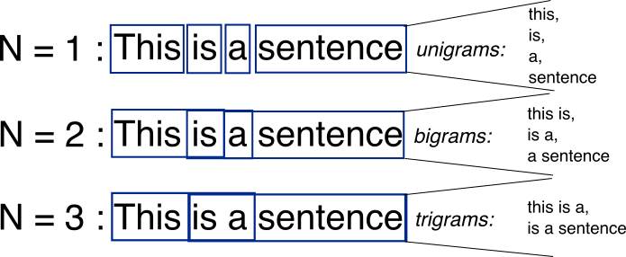
N- gram model:
N-grams: a contiguous sequence of n tokens from a given piece of text

Slide 6
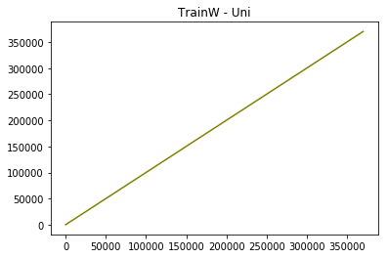
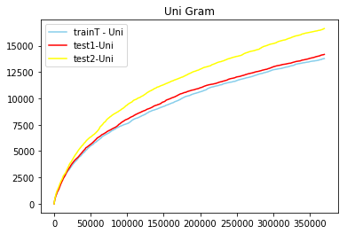
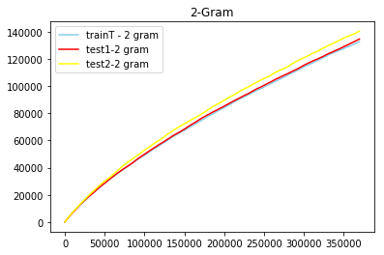
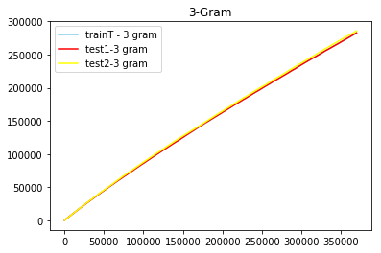
Task 1:
Compute the number of 1-gram, 2-grams (2 consecutive words), 3-grams, 4- and 5-grams. Plot the curve when collecting the data, compare on trainW and trainT.

Slide 7
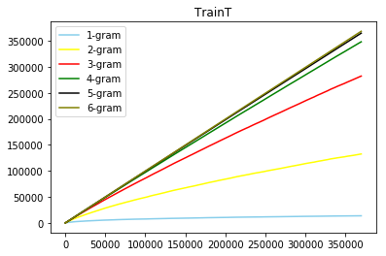


Task 1:

Slide 8
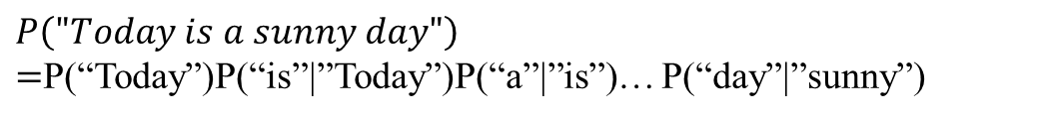
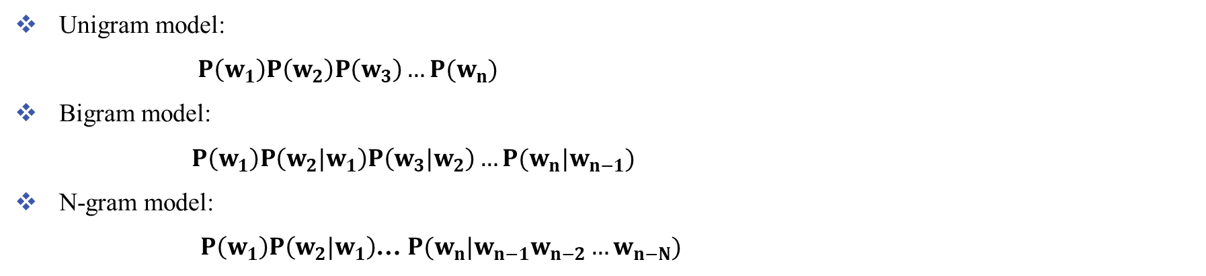
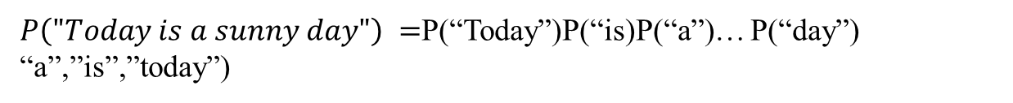
Language model for text
Probability distribution over sentences
$$p\left(w1 w2 … wn\right)=p\left(w1\right)p\left(w_{2} | w_{1}\right)p\left(w_{3} | w_{1},w_{2}\right)…p\left(w_{n} | w_{1},w_{2},…,w_{n−1}\right)$$
$P\left("Today is a sunny day"\right)$ $=$P(“Today”)P(“is”|”Today”)P(“a”|”is”, “Today”)… P(“day”|”sunny”, “a”,”is”,”today”)
N-gram language model assumes each word depends only on the last n-1 words (Markov assumption)
Unigram model:
$P\left(w_{1}\right)P\left(w_{2}\right)P\left(w_{3}\right)…P(w_{n})$
Bigram model:
$P\left(w_{1}\right)P\left(w_{2}|w_{1}\right)P\left(w_{3}|w_{2}\right)…P(w_{n}|w_{n−1})$
N-gram model:
$P\left(w_{1}\right)P\left(w_{2}|w_{1}\right)$… $P(w_{n}|w_{n−1}w_{n−2}…w_{n−N})$
$P\left("Today is a sunny day"\right)$ $=$P(“Today”)P(“is)P(“a”)… P(“day”) “a”,”is”,”today”)
$P\left("Today is a sunny day"\right)$ $=$P(“Today”)P(“is”|”Today”)P(“a”|”is”)… P(“day”|”sunny”)

Slide 9

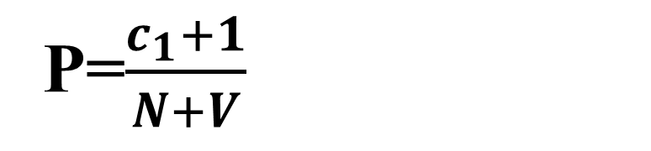
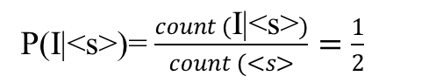
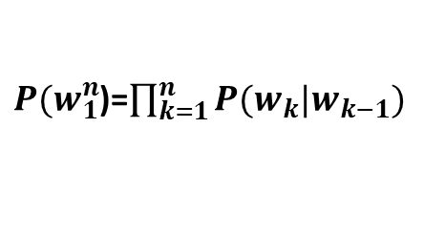
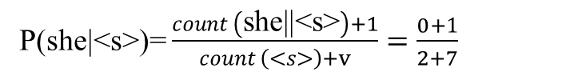
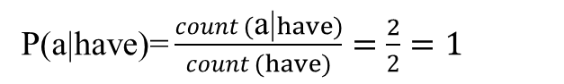
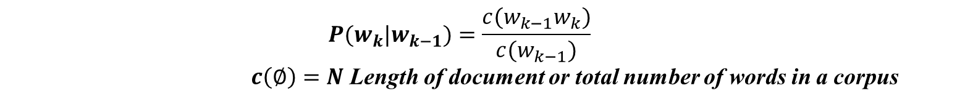
Implement:
For train:
N- Gram:
$P(w_{1}^{n}$)=$\prod_{k=1}^{n}{P(w_{k}|w_{k−1})}$
P(I|<s>)= $\frac{count (\text{I}\text{|<}\text{s}\text{>})}{count (<s>}=\frac{1}{2}$
$$P(w_{k}|w_{k−1})=\frac{c(w_{k−1}w_{k})}{c(w_{k−1})}$$
$c\left(∅\right)=N$ Length of document or total number of words in a corpus
<s> I have a pen
<s> They have a apple
P(a|have)= $\frac{count (\text{a}\text{|}have)}{count (have)}=\frac{2}{2}=1$
For test:
Log- likelihood:
$p_{1}x{ p}_{2 }x$ … ${ p}_{n }=exp(logp_{1}$) + $exp(logp_{2}$)+…… $(logp_{n})$
In case: Word in test not in Train
<s> she have a pen, apple
P(a|have)= 1
Laplace smoothing: merely adds one to each count
P(she|<s>)= $\frac{count \left(\text{she}\text{||<}\text{s}\text{>}\right)+1}{count \left(<s>\right)+v}=\frac{0+1}{2+7}$
P=$\frac{c_{1}+1}{N+V}$
Since we have V unique words
Unseen words/phrases
Laplace smoothing: Laplace smoothing merely adds one to each count

Slide 10
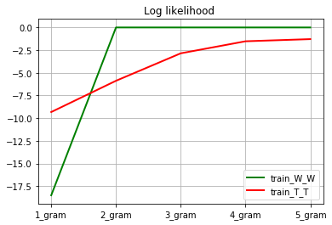
Task 2
Task 2
Compute the likelihood of the training data with a 1-, 2-, 3-, 4- and 5- model
Bigram model: P(aa|a) = 1
trainW
1. a
2. aa
3. aaa
4. aah
5. aahed
…
370102. zwitter
370103. zwitterion
370104. zwitterionic

Slide 11
Interpolation among several n-gram models
Train T_T
Goal: estimate the probability of the word “and”
Model | Estimated probability | Other ngrams with same history
Unigram | P(and) = 0.028 | Many others!
Bigram | P(and|grey) = 0.13 | “grey goose feathers”, “cold grey downpour”
Trigram | P(and|was grey) = 0.80 | “The world was grey darkness, …” “The lower story was grey stone, …”
4-gram | P(and|day was grey) = 1 | None
5-gram | P(and|the day was grey) = 1 | None

Slide 13
Laplace smoothing as model interpolation
Interpolation of individual n-gram models
Interpolation among several n-gram models
What: which models to interpolate?
How: how much to weigh each model during interpolation?
Going further:
Current state of ngram language models
Current state of language models

Slide 14
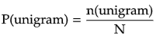
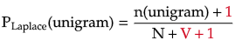
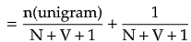
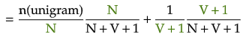
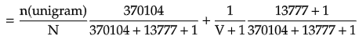
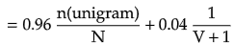
Laplace smoothing as interpolation
Unigram probability:
# of words in training text
Unigram probability
(Laplace smoothing):
unigram vocabulary (# of unique unigrams) in training text
unknown unigram
0.000073
Why interpolate with the uniform?
Assign small probabilities to unknown words in test set
Uniform model

Slide 15
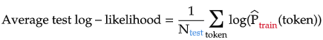
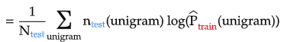
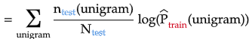
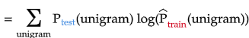
Interpolation of individual n-gram models
Interpolating with uniform = reduce overfit of ngram model
The more similar the unigram distribution between train and test
The higher the average test log-likelihood

Slide 16
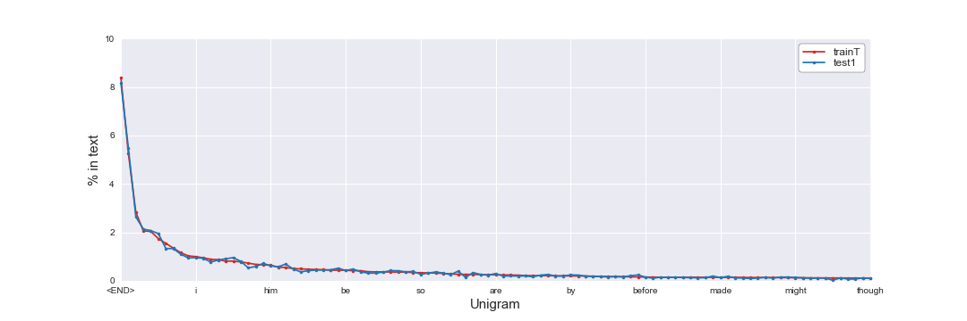
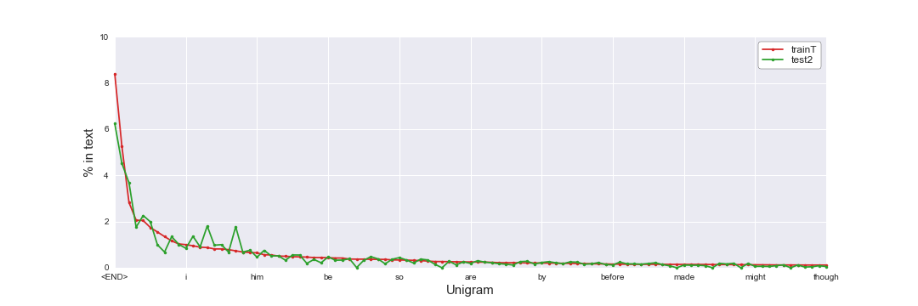
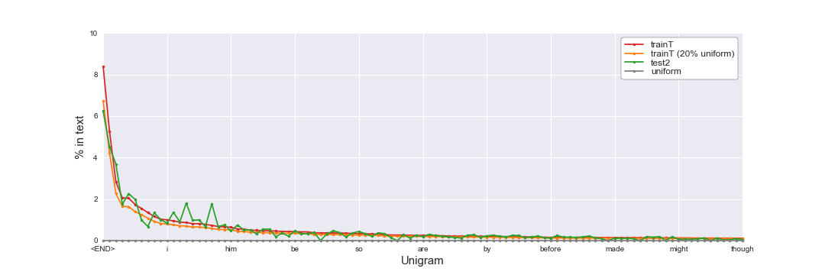
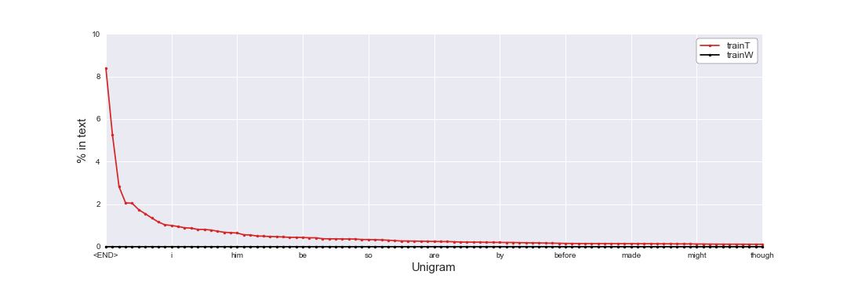
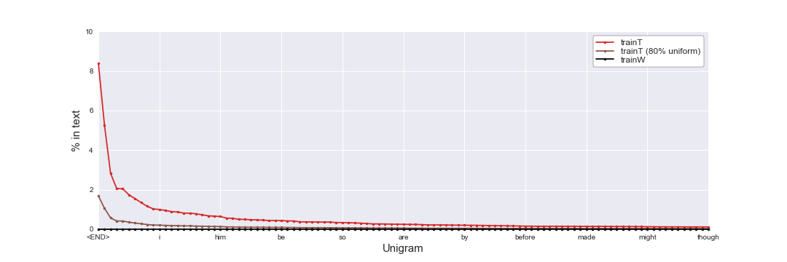
Interpolation of individual n-gram models
Interpolating with uniform = reduce overfit of ngram model

Slide 17
Interpolation of individual n-gram models
Interpolating with uniform = reduce variance of model
Unigram model
(unsmoothed)
Uniform model
https://towardsdatascience.com/holy-grail-for-bias-variance-tradeoff-overfitting-underfitting-7fad64ab5d76

Slide 18
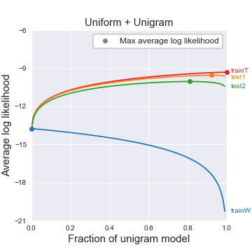
Interpolation of individual n-gram models
Interpolating with uniform = reduce variance of model
High bias
Low variance
Low bias
High variance
100% uniform
100% unigram (unsmoothed)

Slide 19
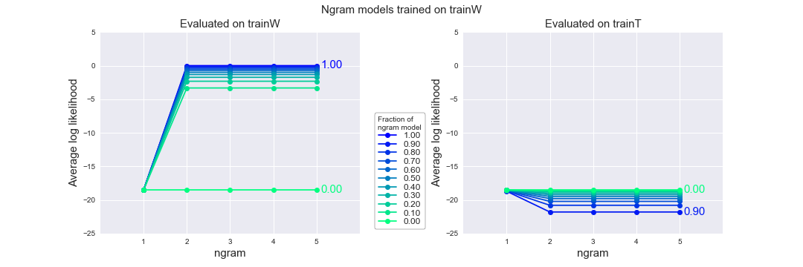
Interpolation of individual n-gram models
trainW => trainW
trainW
1. a
2. aa
3. aaa
4. aah
5. aahed
…
370102. zwitter
370103. zwitterion
370104. zwitterionic
The more interpolation with uniform, the worse the model gets on the training set

Slide 20
Interpolation of individual n-gram models
trainW => trainT
trainW
trainT
1. a
2. aa
3. aaa
4. aah
5. aahed
…
370102. zwitterion
370103. zwitterionic
370104. <END>
1. prologue
2. <END>
3. the
4. day
5. was
…
370102. and
370103. bright
370104. <END>
Interpolating with uniform model improves the model performance on the test set !
P(day|the) = n(the day) / n(the) = 0

Slide 21
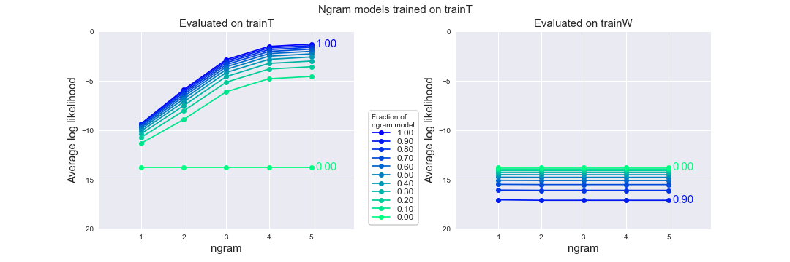
Interpolation of individual n-gram models
trainT => trainT
trainT
1. prologue
2. <END>
3. the
4. day
5. was
…
370102. and
370103. bright
370104. <END>
The more interpolation with uniform, the worse the model is on the training set

Slide 22
Interpolation of individual n-gram models
trainT => trainW
trainW
trainT
1. a
2. aa
3. aaa
4. aah
5. aahed
…
370102. zwitterion
370103. zwitterionic
370104. <END>
1. prologue
2. <END>
3. the
4. day
5. was
…
370102. and
370103. bright
370104. <END>
Interpolating with uniform model improves the model performance on the test set !
P(aaa) = 0
P(aaa|aa) = n(aa aaa) / n(aa) = 0
“Statistical models are likely to be useless as predictors if the training sets and the test sets are as different as Shakespeare and The Wall Street Journal” – Jurafsky & Martin (2019)
Choice of dataset matters a lot!

Slide 23
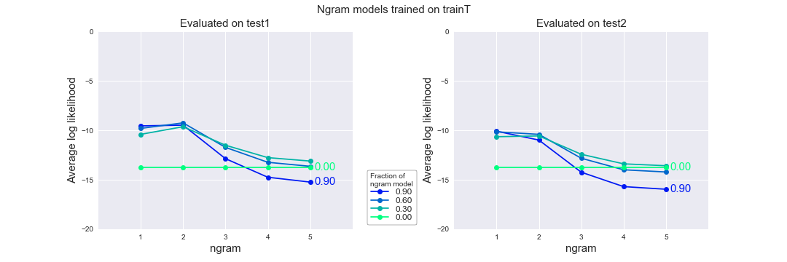
Interpolation of individual n-gram models
trainT => test1
trainT
test1
1. prologue
2. <END>
3. the
4. day
5. was
…
370102. and
370103. bright
370104. <END>
1. prologue
2. <END>
3. the
4. night
5. was
…
370102. play
370103. the
370104. <END>
Bigram model is slightly better than unigram model

Slide 24
Interpolation of individual n-gram models
trainT => test1
Example:
P(yarwyck) = 0.000003
P(yarwyck|othell) = 1
Othell Yarwyck
Bigram model is slightly better than unigram model

Slide 25
trainT => test1
Why?
Many new trigrams, 4-gram, 5-gram in test1 that have never appeared in trainT
=> P(ngram) = 0
Out of 370104 tokens in test1:
4788 new unigrams
113861 new bigram
246254 new trigrams
299264 new 4-grams
310940 new 5-grams
Complex != better (especially when data is small)
Higher ngram models perform terribly!

Slide 26
Interpolation of individual n-gram models
trainT => test2
Performance on test2 is slightly worse than on test1 (for same ngram and interpolation with uniform)

Slide 27
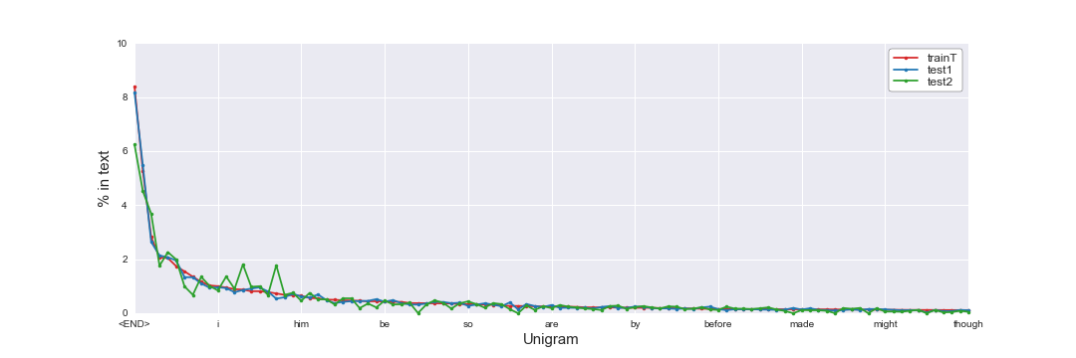
Why is model worse on test2 than test1 ?
Interpolation of individual n-gram models
Ngram distribution different effect: test2 has different ngram distribution to trainT than train1

Slide 28
Why is model worse on test2 than test1 ?
Interpolation of individual n-gram models
Unknown ngram effect: test2 has much more new ngrams than train1
New ngram (ouf of 370104 ngrams) | Test1 | Test2
Unigram | 4788 | 9331
Bigram | 113861 | 163999
Trigram | 246254 | 285432
4-gram | 299264 | 326694
5-gram | 310940 | 333143

Slide 29
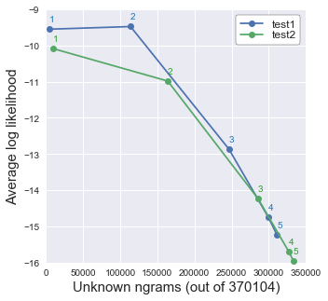
Why is model worse on test2 than test1 ?
Interpolation of individual n-gram models
Ngram distribution difference effect dominates for lower ngram models
Unknown ngram effect dominates for higher ngram models
Choose training sets that are similar to your NLP task

Slide 30
In most cases, interpolating with the uniform model improves the model performance on test set !
Interpolation of individual n-gram models

Slide 31
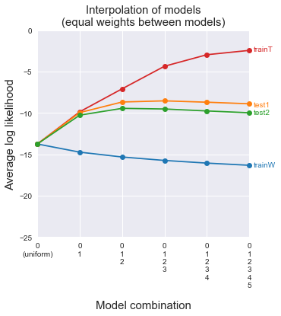
What to interpolate: which models to include?
Interpolation among several n-gram models
Higher n-gram models do not help
Unigram and bigram models help

Slide 32
How to interpolate: how to weight model contributions?
Interpolation among several n-gram models
Average weighting:
Custom weighting:
Objective function:

Slide 33
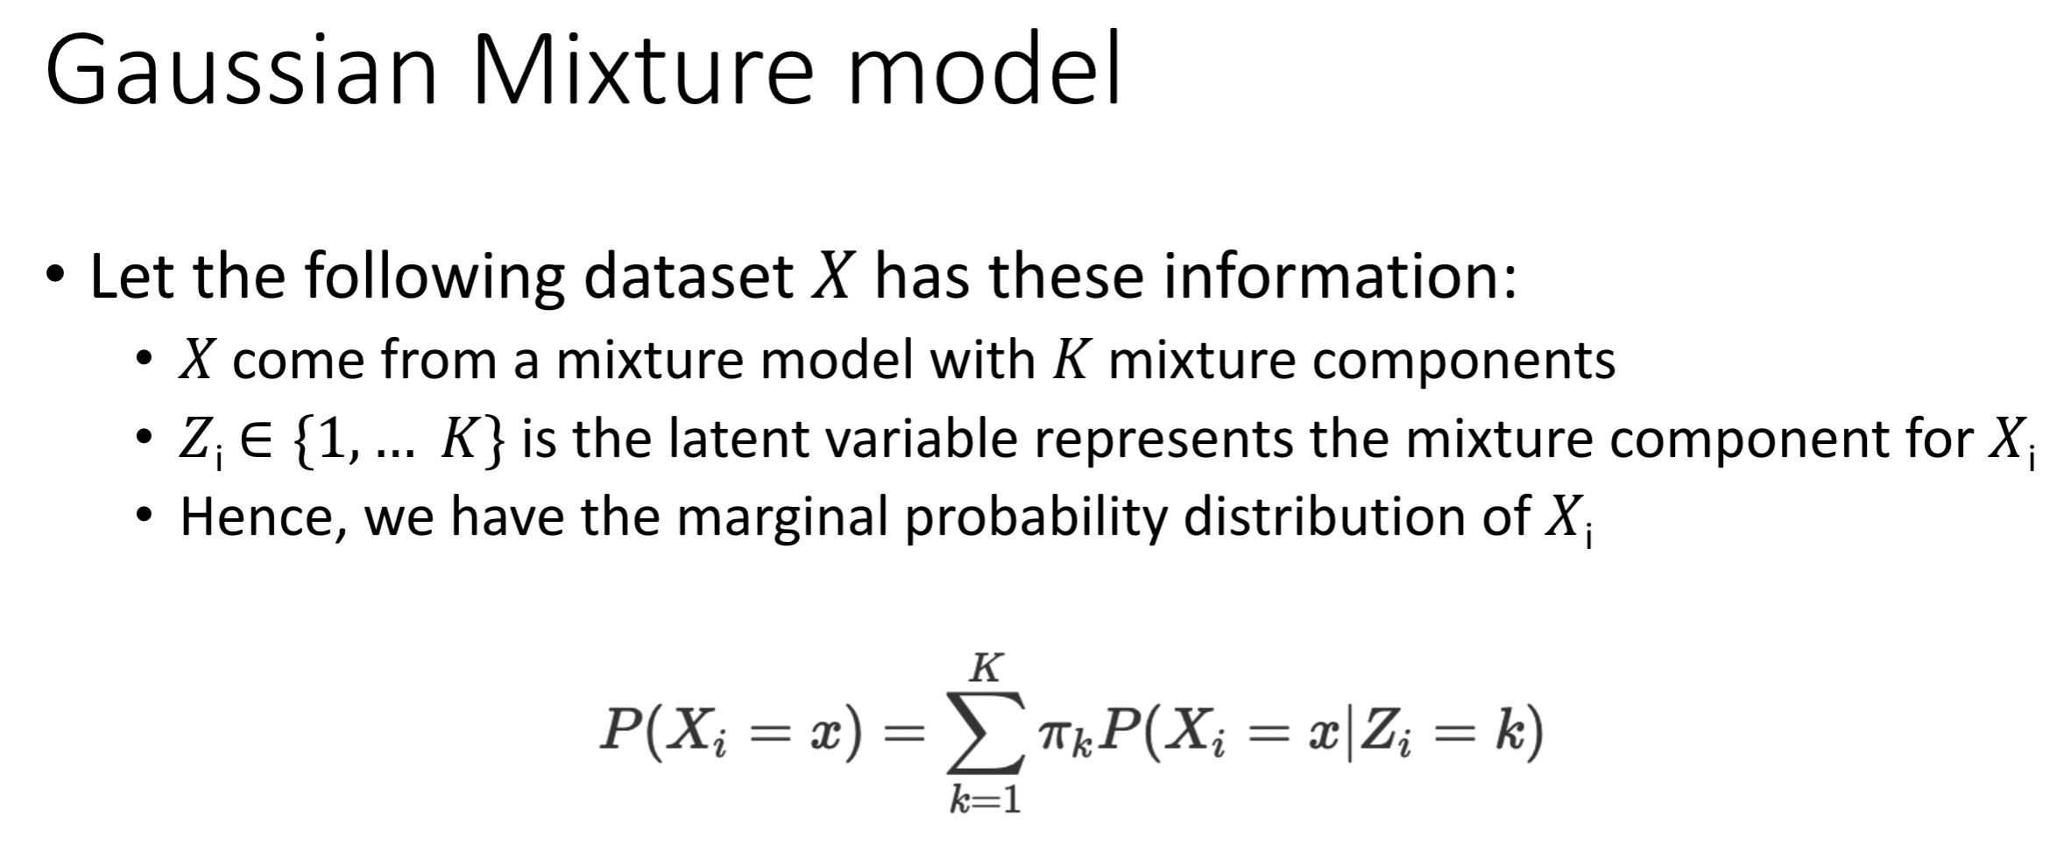
How to interpolate: how to weight model contributions?
Interpolation among several n-gram models
Phuc & Huy 2019 “Gaussian Mixture Model”

Slide 34
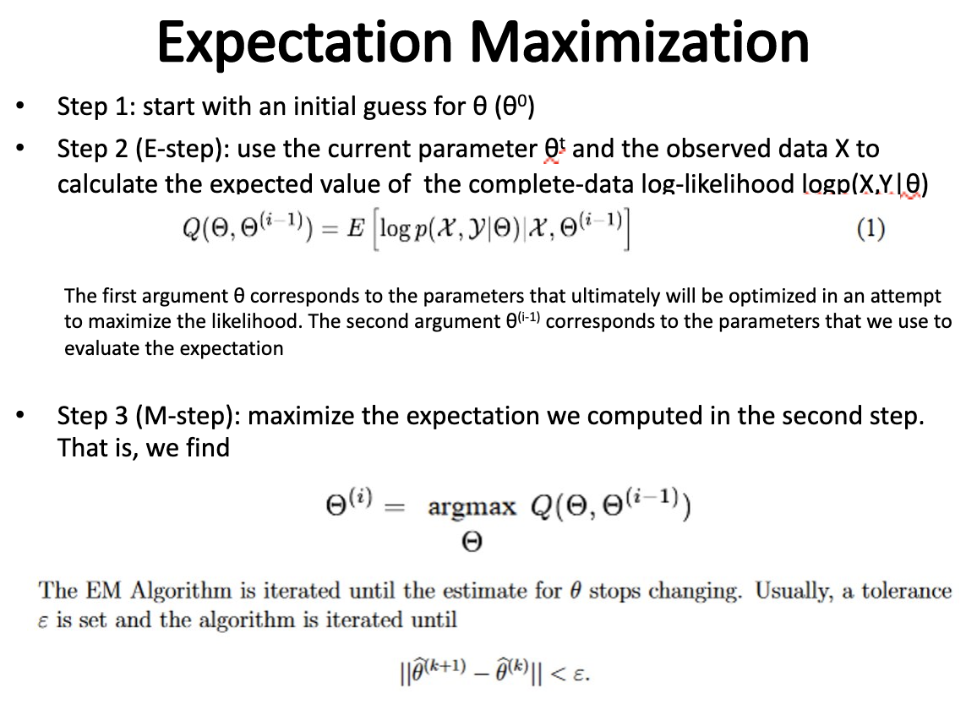
How to maximize objective function?
Interpolation among several n-gram models
Objective function:
Approaches:
Gradient descent
Mai 2019 “Expectation Maximization”

Slide 35
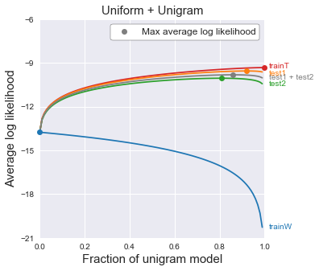
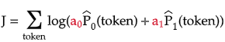
How does EM work?
Interpolation among several n-gram models

Slide 36
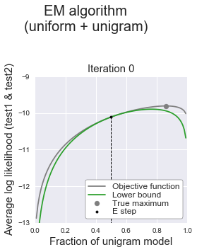
Step 1: Expectation (E-step)
Interpolation among several n-gram models
Construct a lower bound to objective function at some point

Slide 37
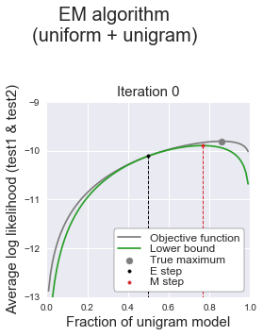
Step 2: Expectation (M-step)
Interpolation among several n-gram models
Maximize the lower bound of the objective function

Slide 38
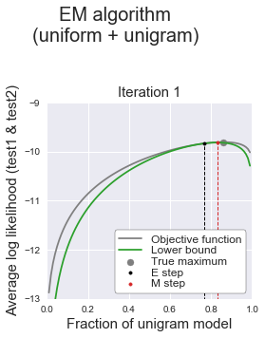
Step 3: Repeat E-step & M-step until convergence
Interpolation among several n-gram models

Slide 39
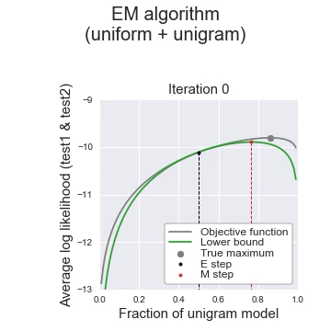
Visualize EM algorithm
Interpolation among several n-gram models

Slide 40
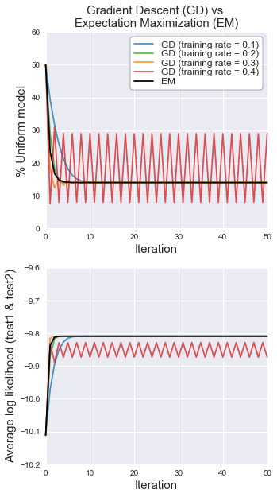
Why EM algorithm?
Ensure mixture weights add up to 1
Do not need to set learning rate (unlike gradient descent) !
Disadvantage: often converges to local max (not a problem here)

Slide 41
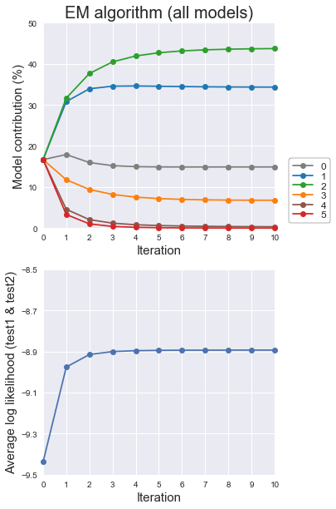
Interpolate all ngram models with EM
Interpolation among several n-gram models

Slide 42
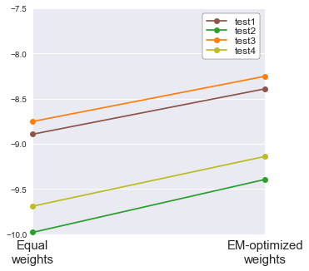




Final benchmark of EM algorithm
Interpolation among several n-gram models

Slide 43

Current state of ngram models
Going further
Alternative to interpolation of ngram models: backoff models
https://www.cs.cornell.edu/courses/cs4740/2014sp/lectures/smoothing+backoff.pdf
Selection of ngram models:
Good-Turing smoothing
Jelinek-Mercer smoothing
Church-Gale smoothing
Witten-Bell smoothing
Katz backoff
Good-Turing backoff
Stupid backoff
Kneser-Ney smoothing
Interpolated Kneser-Ney smoothing
Modified Kneser-Ney smoothing
Modified interpolated Kneser-Ney smoothing

Slide 44

Current state of language models
Going further
Disadvantage of ngram language models
They are big
They are dumb
Current SOTA (state-of-the-art) models
Word embeddings learned by neural networks (RNNs, transformers)
I know ”Hulk Smash”, but what is “Hulk Crash” ?

Slide 45
Summary
Choice of dataset matters
More complex != better (especially when data is small)
Interpolate ngram models with uniform model to improve model performance on test set (less overfit, lower variance)
Use EM to best determine interpolation weights between models
If you want to build a language model in 2020, look to neural networks, not ngram models

